Slide 1


Smart NFC Card Application
Vast Expanse (Team 7)

Slide 2
Last Time…
General Project Description
Domain Model
3 Use Cases
SRS
Testing Approach

Slide 3
This Time…
Architectural Design
Various New Documentation
Quality Requirements
Automated Unit and Integration Testing
3 Use Cases

Slide 4
Link – a Recap
Link is a business networking tool, to be used by employees of companies to connect to and host potential clients of the company.
It is built as a mobile phone application for employees, as well as a web interface to be used by Link admins as well as representatives of a company. This is used to add new companies and to add employees to these companies.
Last time, we showed 3 use cases: the creation, sharing and viewing of Virtual Business Cards through the use of NFC over the Link app.

Slide 5
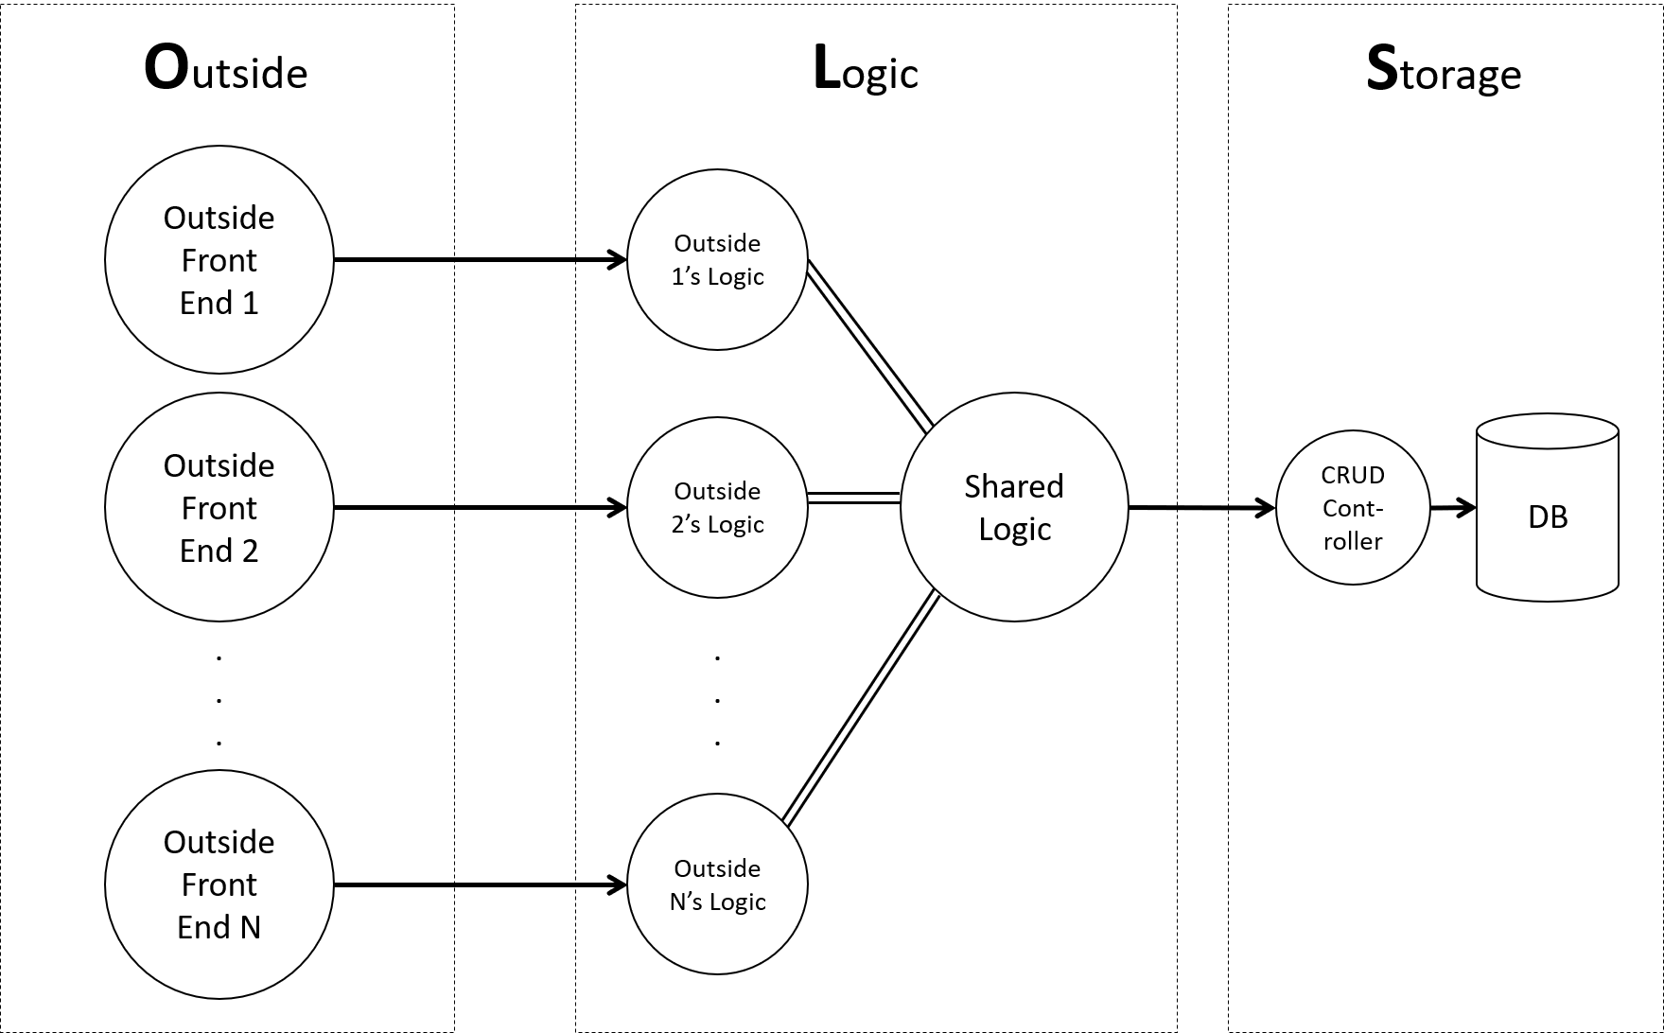
Architectural Design
The brand-spanking new OLS architectural design pattern

Slide 6
OLS Architectural Design
O(utside)
These components in this layer represent the various front-end subsystems which will be used to access the Link backend server
They only talk to one sub-component in the Logic layer, minimizing coupling
L(ogic)
The sub-components here represent an interface with which an outside subsystem can access the Link backend server
New sub-components can be easily added for a new system to integrate with, with Shared Logic
S(torage)
Persistent storage in the application is implemented and controlled here, as a database
An API wrapper is placed on the database, the CRUD Controller, which allows for logical queries of the database, independent of structure

Slide 7
OLS Advantages
Low coupling between database and rest of the application
Easily integrates with other outside subsystems
Allows for easy standardization across application and avoids re-definition

Slide 8
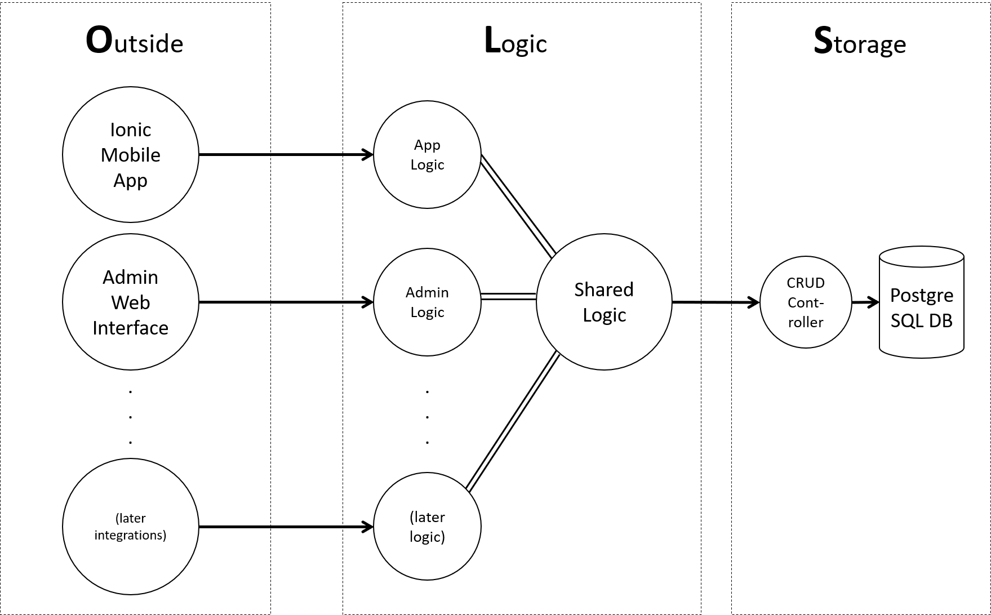
How we used OLS

Slide 9
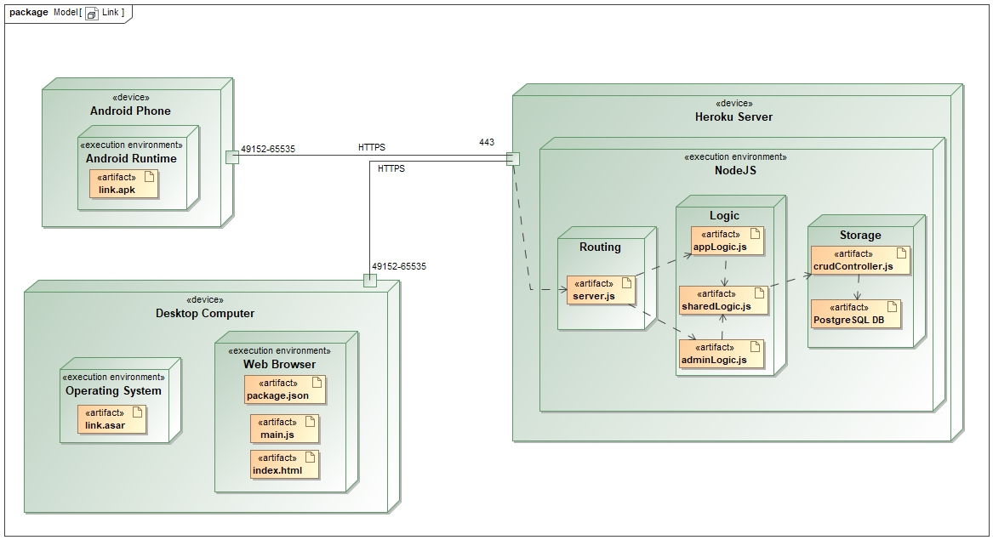
OLS in Deployment

Slide 10
Quality Requirements
Extendibility
The use of Shared Logic (essentially a mixin class) allows for easy extending of our interfaces to the outside world, complying to our standards and with all the shared functionality available that the other layers have
Graphical User Interface
The use of Ionic and, later, Electron will ensure that our user interfaces are slick and understandable, with the focus first being on UX and then UI, ensuring user understanding comes first

Slide 11
Quality Requirements
Security
The wrapping of the database by the CRUD Controller means that this component can have its own independent security checks before allowing access to data/modification of data (e.g. prepared statements, security level clearance). API Key validation is already in place and will be further extended
Testability
There already are many unit tests written for the application, using a built in demoMode feature which allows for unit tests and integration tests to be called in the same way, but with the addition of a demoMode parameter for unit tests. This tests both ‘cognitive’ and ‘social’ compliance. Tests are already automated using TravisCI.

Slide 12

Demo Time! UC1
Get a Virtual Business Card

Slide 13

Demo Time! UC2
Create Company

Slide 14
Demo Time! UC3
Create Employee

Slide 15

Automated Testing
Unit and Integration Tests

Slide 16

Automated Testing
Continuous Integration and Deployment

Slide 17
THANK YOU
* Cool stuff? We created our own architectural design pattern!

